Slide 1
Lab 3
Dining Philosophers with Message Passing
NEU – 2016

Slide 2
Lab #3
Implement a working Dining Philosopher program using MPI
Message Passing Interface (MPI)
Installed on Linux machines (Virtual Machine)
sudo apt-get install mpich2 mpich2-doc
PATH=$PATH:.
mpirun –n 5 program
Creates multiple instances of processes
Understand components of one another
Can communicate with each other via messages

Slide 3
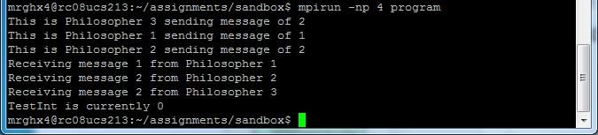
MPI
MPI initialization combined with mpirun
Each process knows about the others
Each process executes an identical copy of the code
Each instance acts as a process not a thread
Nondeterministic message interleaving
Notes:
Global variables are not global across MPI processes.

Slide 4
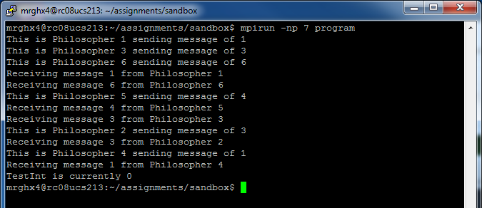
No easy way to decipher the global (total) ordering of all activities (all cout gets passed back to node 0 via MPI)
Best to only have Master do output…

Slide 5
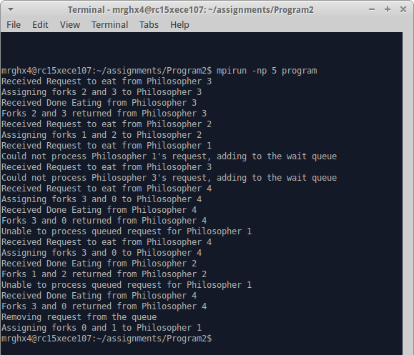

Slide 6
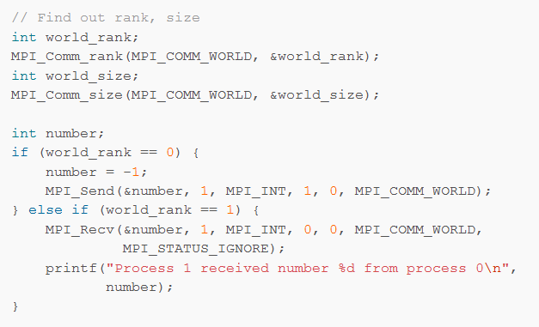
MPI code (C style)

Slide 7
Dining Philosophers
The Master Node – controls forks/chopsticks
Manages when forks are in use, free, and desired
Will report to philosophers when they can eat
Will receive from philosophers when done eating
Philosophers
Sleep for some random (finite) amount of time
Become hungry and request to use their 2 assigned forks
When notified they can eat, eat for some random (finite) amount of time
“Return” the forks to the fork ombudsman
Repeat (i.e., go back to sleep again)

Slide 8
What messages do we send?
MPI_INT can send integers
0 = exit/shutdown
1 = I’d like to eat
2 = you can eat
3 = …

Slide 9
Considerations
Adding in a mechanism to end
Time based, number of ‘eats’, etc.
Blocking send/receive calls can lead to deadlock
Due BY midnight Monday June 6th
Upload source code to Blackboard
Comment code & possibly include a text file describing code operation

Slide 10
For Additional Reference
MPI Tutorial
MPI tutorial introduction
Sending and receiving with MPI_Send and MPI_Recv
Dynamic receiving with MPI_Probe and MPI_Status
Point-to-point communication application - Random walking

